Slide 1
Burger-ler
Tarrance Nealey
Marc Swasey
Ian Johnson

Slide 2
What The Heck Is A Burger-ler ?
For those people who have been in the situation of leaving the room while your lunch box is unoccupied, I think you should stay tuned. This invention is a self alarmed lunch box. Yes. An alarm. By simply opening the lunch box without moving the hidden switch makes it go off. Loud … really loud. You will be able to hear this distinctive sound from hallways away.

Slide 3
Why Us ?
We are the only company to build a hidden alarm with such a roar. This is nice plastic container and very spacious. It has a handle ( good for carrying ) and its also insulated. This lunch box is twice the size of your average lunch holder and the same size. Wow !

Slide 4
Prices and Feature
For such an incredible invention we are giving this away for the lowest price in the market. This is a $100.00 value that we are giving you for the low… super low … price of only $19.95. We have this lovely and cheap lunch box in many colors. We now offer red, blue, yellow, pink, and black. For an additional price of $7.95, you can personalize your box any way you want. You call it nice. We call it eating safe.

Slide 5
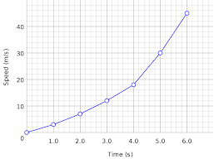
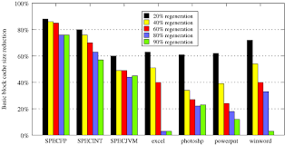
The rise of safe lunches since our product launch.
Your Savings With Us !
Us Vs. Competitors

Slide 6
A Nice Cheap Way To Keep Your Food Safe
Be This Guy ! ! !
Don’t Be This Guy

